Slide 1
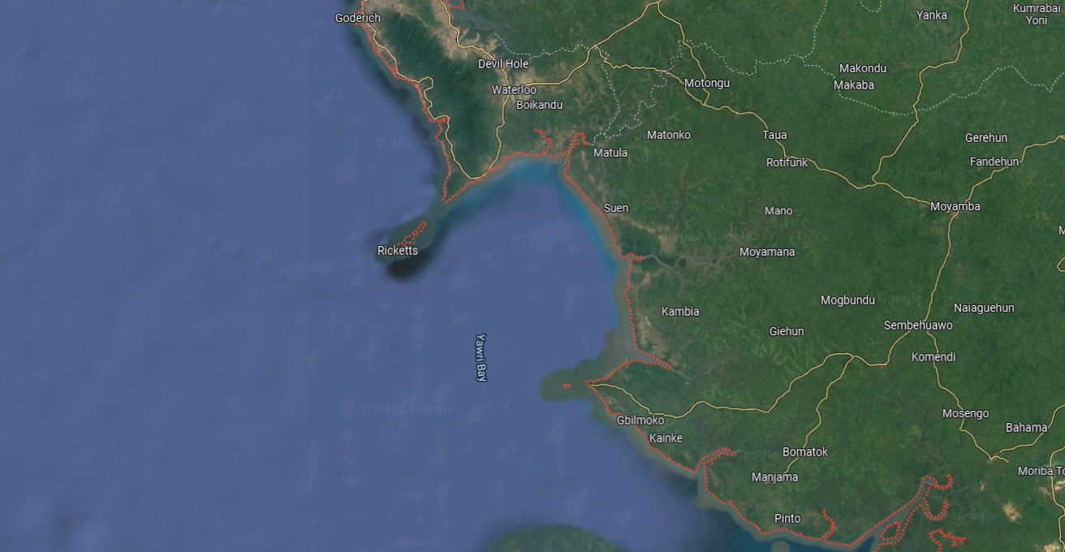

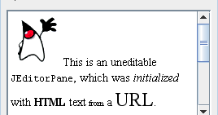
SE O MOUSE PASSAR POR CIMA / CLICAR
Clock (00:0000)
BF123 (HELI)
-45.32,-123.23
Speed: 42m/s
Level: 124ft
BF123
CTask: T123
NTask: T124
Id | Type | Force | Ctask | NTask | Status | Risk | Opportunity | Cost
BF123 | HEL | BLUE | T123 | T124 |  | 90% | 60% | 80%
BF177 | FIGHTER | RED | T321 | NONE |  | 10% | 100% | 90%

Slide 2



Air Force Symbols
NATO JOINT MILITARY SYMBOLOGY
AEW
ELECTRONIC MEASURES
ANTISUBMARINE
WARFARE
UNMANNED AERIAL VEHICLE
VERY
IMPORTANT
PERSON
PATROL /
RECONNAINSSANCE
FIGHTER
CARGO
TANK
CSAR
HELI
MISSILE
F
C
K
AEW
ASW
CSAR
VIP
P/R
F
C
K
AEW
ASW
CSAR
VIP
P/R
F
C
K
AEW
ASW
CSAR
VIP
P/R

Slide 3

Land Force Symbols
NATO JOINT MILITARY SYMBOLOGY
UNMANNED LAND VEHICLE
AIR DEFENSE
SYSTEM
VERY
IMPORTANT
PERSON
SPECIAL
FORCES
SEA AIR
LAND (SEAL)
GUN FIRE
SYSTEM
ARTILLERY
MORTAR
SF
SEAL
VIP
SF
SEAL
VIP
SF
SEAL
VIP

Slide 4
Land Force Symbols
NATO JOINT MILITARY SYMBOLOGY
ELETRONIC
WARFARE
CRITICAL
INFRA
SUPPLY
TANK
MINE
SPY
CIVILIAN
EW
SPY
CIV
EW
SPY
CIV
EW
SPY
CIV

Slide 5
Land Force Symbols
NATO JOINT MILITARY SYMBOLOGY
PLATOON
(25 TROOPS)
COMPANY
(250 TROOPS)
BATALLION
(1k TROOPS)
BRIGADE
(2k TROOPS)
ARMY
(100k TROOPS)
COMMAND
HQ
I
II
X
XXXX
I
II
X
XXXX
I
II
X
XXXX

Slide 6

Sea Surfaces Forces
NATO JOINT MILITARY SYMBOLOGY
UNMANNED SURFACE VEHICLE (USV)
CRUISER
DESTROYER
FRIGATE
AMPHIBIOUS
AEROCARRIER
MINE
PATROL BOAT
CIVILIAN
TORPEDO
CG
DD
FF
LS
CG
DD
FF
LS
CG
DD
FF
LS

Slide 7
Sea Subsurface Symbols
NATO JOINT MILITARY SYMBOLOGY
UNMANNED UNDERWATER VEHICLES (UUVS)
SUBMARINE
NUCLEAR
SUBMARINE
CONV
N
N
N

Slide 8



Space Symbols
NATO JOINT MILITARY SYMBOLOGY
Cyber Symbols
SPACE
VEHICLE
SATELLITE
CYBER RANGERS
SV
SV
SV

Slide 9

XPTO
XPTO2
id
comm
forces
Blue, red, neutral
sensor
aggressivity
weapon

